Slide 1
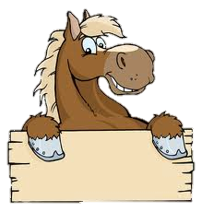
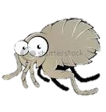
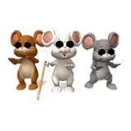
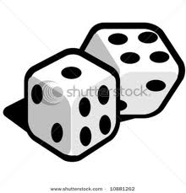
Boom Boom
Boom Boom ain’t it great to be crazy?
Boom Boom ain’t it great to be crazy?
Silly and foolish all day long
Boom boom ain’t it great to be crazy
Horse and a flea and three blind mice
Sit on a curbstone shooting dice
The horse he slipped and fell on a flea
“Whoops!” said the flea, “there’s a horse on me!”

Slide 2
Boom Boom ain’t it great to be crazy?
Boom Boom ain’t it great to be crazy?
Silly and foolish all day long
Boom boom ain’t it great to be crazy
Way up North where there’s ice and snow
There was a penguin his name was Joe
He got so tired of black and white
He wore pink pants to the dance last night

Slide 3
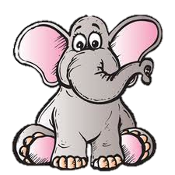
Boom Boom ain’t it great to be crazy?
Boom Boom ain’t it great to be crazy?
Silly and foolish all day long
Boom boom ain’t it great to be crazy
Way down south where bananas grow
A flea stepped on an elephant’s toe
The elephant cried with tears in his eyes
“ Why don’t you pick on someone your size!”

Slide 4
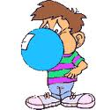
Boom Boom ain’t it great to be crazy?
Boom Boom ain’t it great to be crazy?
Silly and foolish all day long
Boom boom ain’t it great to be crazy
Teacher says no gum in school
Spit it out cos that’s the rule
“That’s not fair!” little Johnny said
“ I can’t spit it out, cause it’s stuck in my head!”

Slide 5
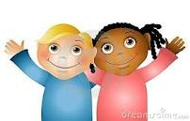
Boom Boom ain’t it great to be crazy?
Boom Boom ain’t it great to be crazy?
Silly and foolish all day long
Boom boom ain’t it great to be crazy

Slide 6
Sing with backing

Slide 7
Boom Boom
Boom Boom ain’t it great to be crazy?
Boom Boom ain’t it great to be crazy?
Silly and foolish all day long
Boom boom ain’t it great to be crazy
Horse and a flea and three blind mice
Sit on a curbstone shooting dice
The horse he slipped and fell on a flea
“Whoops!” said the flea, “there’s a horse on me!”

Slide 8
Boom Boom ain’t it great to be crazy?
Boom Boom ain’t it great to be crazy?
Silly and foolish all day long
Boom boom ain’t it great to be crazy
Way up North where there’s ice and snow
There was a penguin his name was Joe
He got so tired of black and white
He wore pink pants to the dance last night

Slide 9
Boom Boom ain’t it great to be crazy?
Boom Boom ain’t it great to be crazy?
Silly and foolish all day long
Boom boom ain’t it great to be crazy
Way down south where bananas grow
A flea stepped on an elephant’s toe
The elephant cried with tears in his eyes
“ Why don’t you pick on someone your size!”

Slide 10
Boom Boom ain’t it great to be crazy?
Boom Boom ain’t it great to be crazy?
Silly and foolish all day long
Boom boom ain’t it great to be crazy
Teacher says no gum in school
Spit it out cos that’s the rule
“That’s not fair!” little Johnny said
“ I can’t spit it out, cause it’s stuck in my head!”

Slide 11
Boom Boom ain’t it great to be crazy?
Boom Boom ain’t it great to be crazy?
Silly and foolish all day long
Boom boom ain’t it great to be crazy

